Slide 1
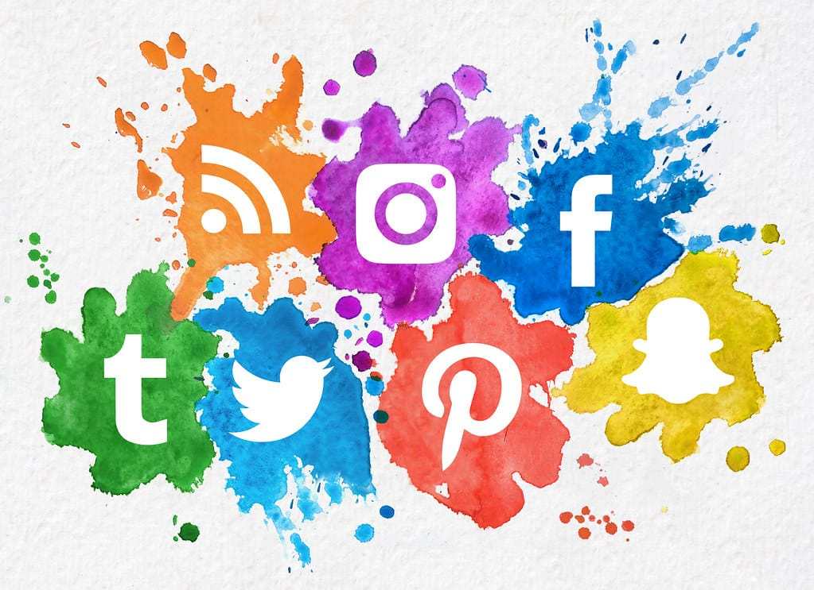
f
CHANGING BEHAVIOURS
DUE TO
SOCIAL MEDIA

Slide 2
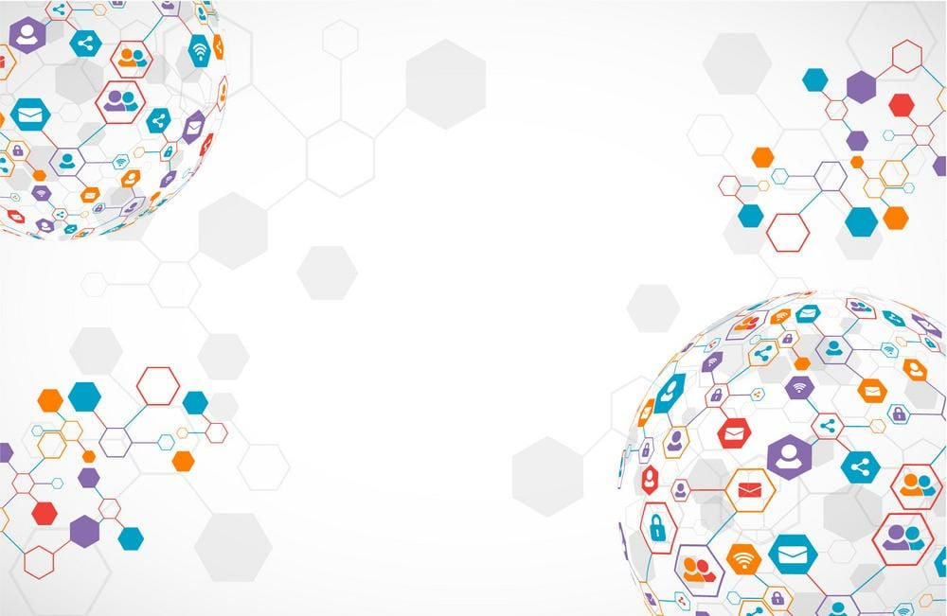
CONTENTS:
WHAT IS SOCIAL MEDIA?
SERVICES OF SOCIAL MEDIA
CHANGE IN BEHAVIOUR IN A POSITIVE WAY
CHANGE IN BEHAVIOUR IN A NEGATIVE WAY
ROLE OF SOCIAL MEDIA IN OUR LIVES
FACTS AND FIGURES…
CONCLUSION…
ANY QUESTIONS ?

Slide 3

“SOCIAL MEDIA HAS CHANGED NOT ONLY OUR POWERS OF THINING
,BUT TODAY GOVERNS OUR BEHAVIOUR AND SOCIAL CONDUCTS
AS WELL”

Slide 4

WHAT IS SOCIAL MEDIA ?
We live in the age of web which is highly equipped with SOCIAL MEDIA. Social media can be defined as a collective term for the websites and applications that focus on communication, interaction, content sharing etc. It is a computer based technology with the help of which we can connect to each other.

Slide 5

SERVICES OF SOCIAL MEDIA
BLOGGING SITES LIKE TWITTER, LINKEDIN ETC.
SOCIAL NETWORKING SITES SUCH AS FACEBOOK, INSTAGRAM, SNAPCHAT ETC.
SHOPPING SITES SUCH AS AMAZON, FLIPKART, MEESHO ETC.
ONLINE VIDEO SHARING PLATFORMS LIKE NETFLIX, AMAZON PRIME, YOUTUBE ETC.

Slide 6
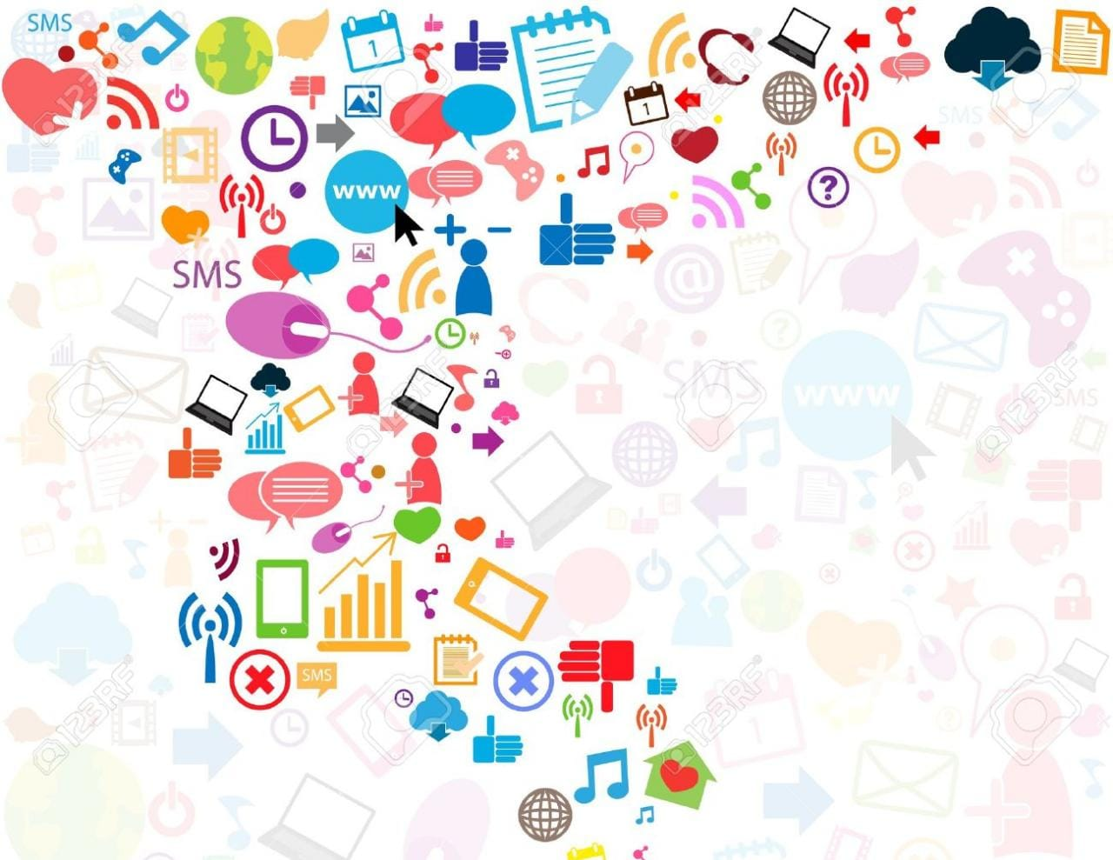
CHANGE
IN
BEHAVIOUR
IN A
POSITIVE WAY

Slide 7

Outlet for creativity and self expression
Learning and education
Form new networks
Join or promote worthwhile causes and self awareness
Communication with family and friends
Building a business through social media marketing
Spreading News

Slide 8
CHANGE
IN
BEHAVIOUR
IN A
NEGATIVE WAY

Slide 9
By making us sad seeing people having fun
Comparing our lives with others
Thinking we have so many friends
Increasing trust with strangers
Face to face interactions have been removed
Reel vs Real

Slide 10
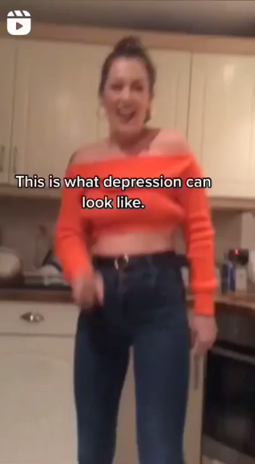

Slide 11
Social media’s violent games result in violent tendencies and behavior in children
Causes stress and anxiety
Negative body image
Unhealthy sleep patterns
General addiction
    Spreading of negativity and rumors online
Privacy

Slide 12
ROLE OF SOCIAL MEDIA IN OUR LIVES…
• Changed the way of living.
• Exchange of Information.
• Social Media and Business
• Social Media - A Drug.
• Creates Illusion.

Slide 13
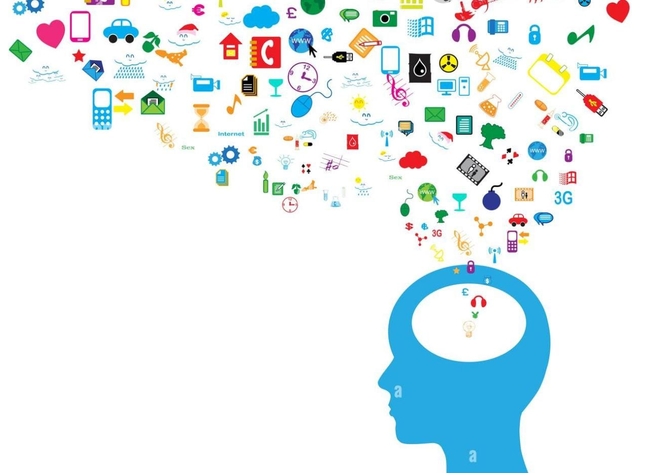
FACTS
AND
FIGURES…

Slide 14
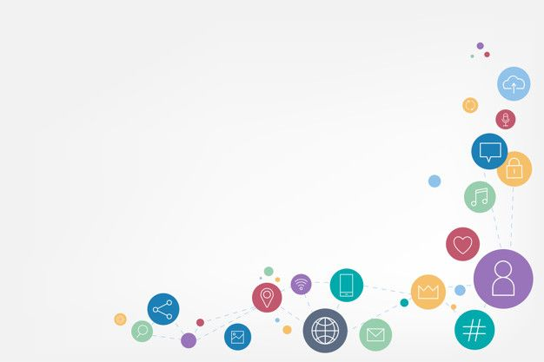
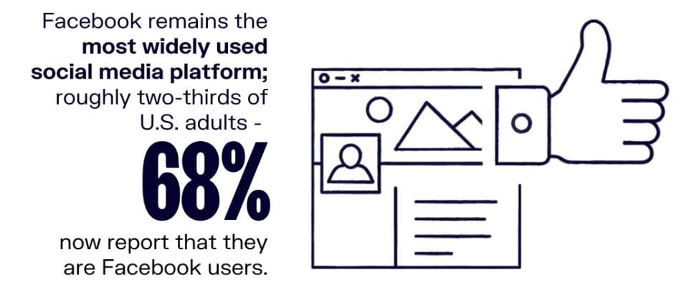
FACEBOOK IS THE MARKET LEADER

Slide 15
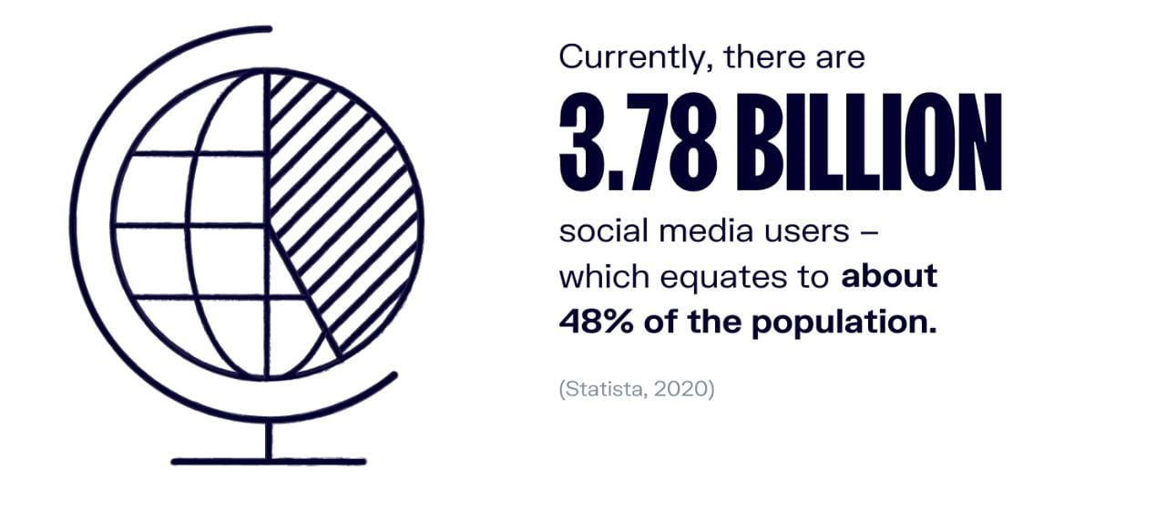
DAILY ACTIVE SOCIAL MEDIA USERS

Slide 16
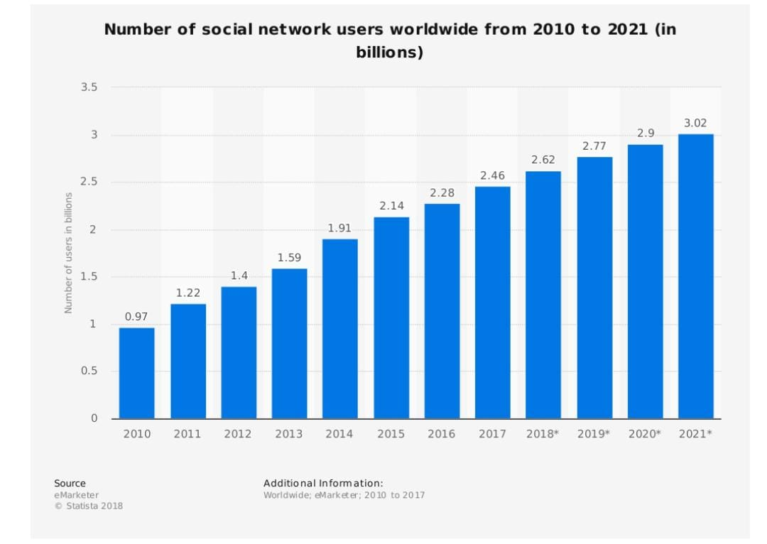

Slide 17
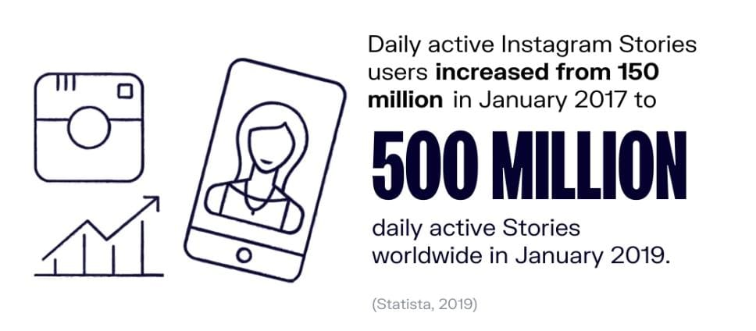
INSTAGRAM STORIES USAGE

Slide 18
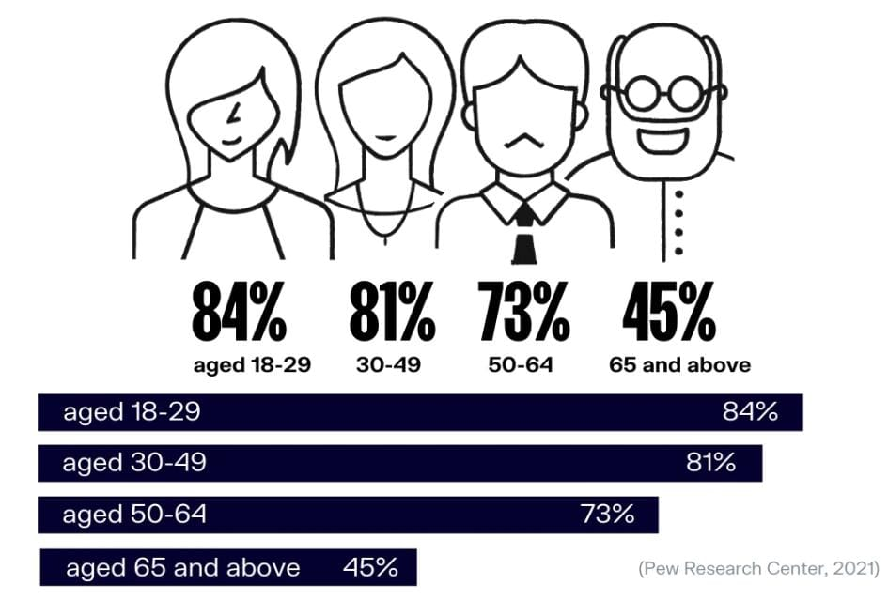
SOCIAL MEDIA USERS BY GENERATION

Slide 19
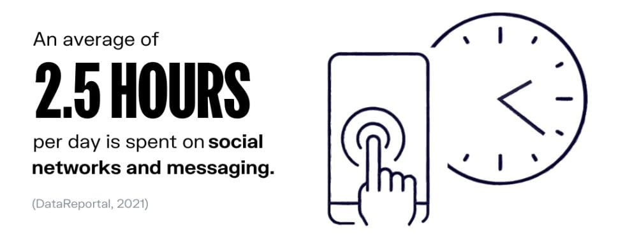
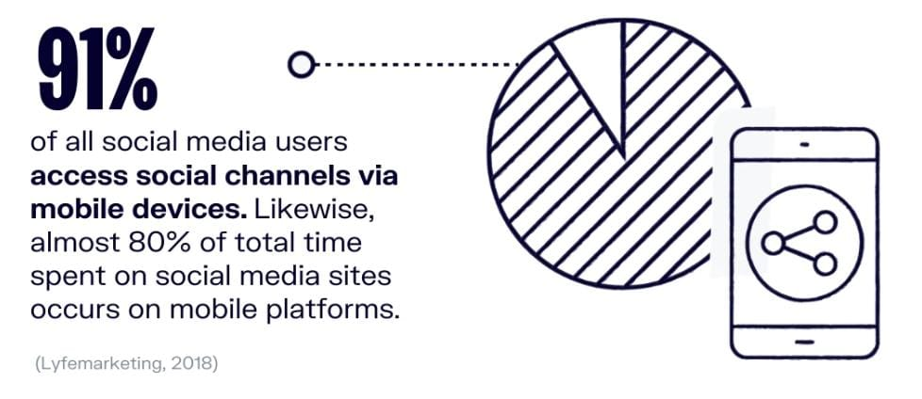
TIME SPENT ON SOCIAL MEDIA
PER DAY

Slide 20
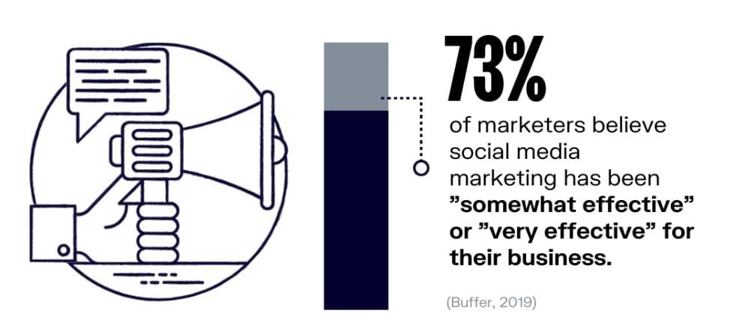
THE POWER OF SOCIAL MEDIA MARKETING

Slide 21
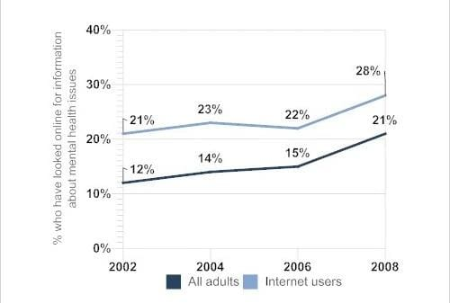
STATISTICS OF INTERNET USERS HAVING MEANTAL HEALTH ISSUES…

Slide 22
CONCLUSION…
The effects from social media are very complex and vary from person to person.
There are both the negative and positive impacts of social media. So, it basically depends on the individual itself how he/she
wants their life to be affected.
REMEMBER :
“ITS SO GOOD THAT
ITS BAD…..”

Slide 23

ANY
QUESTIONS ?

Slide 24


THANK
YOU!

